Slide 1
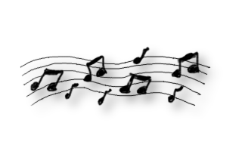
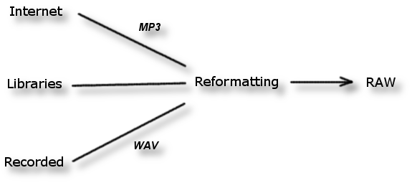



Audio
Constraints
  Low quality/size
  RAW format
  1 channel (Mono)
  16 hardware sound channels

Slide 2

Audio
Music Tracks
  Required to loop seamlessly
  Matches the mood of the game
  Cannot be repetitive
Sound FX
Menu
Button 1
Button 2
Level
Menu Background Music Sample
Fish Collectable
In-Game Background Music Sample
Penguin Footsteps
Penguin Splash

Slide 3
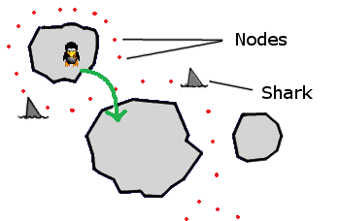

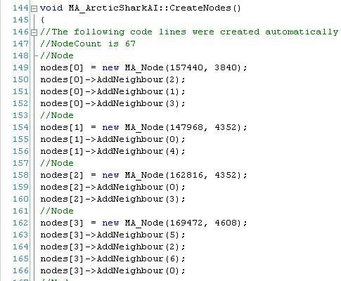

A.I.
Shark AI
  Loiters around penguin jump points
  Navigates around the map
  Unpredictable route
  No collision checking on ice
  Automatic code generation for nodes
Bitmap
Code

Slide 4

Risks
Technical
  Integration of code into new PALIB version
  Hmmmm….

Slide 5
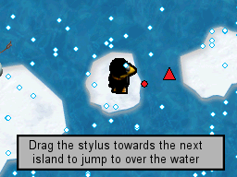
Tutorial
Goals
  Improves players’ control competence
  Shows the main rules of the game
  Allows younger players to understand the game
  Looks professional
Features
  Step-by-step guide to UI and control scheme
  Audio and textual instructions

Slide 6
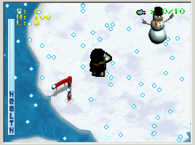
Demonstration
Video of a level prototype

Slide 7


